Slide 1
A Graphy Kata
The SQL Whiteboard Challenge
November, 2020
KROLL BOND RATING AGENCY, INC

Slide 2
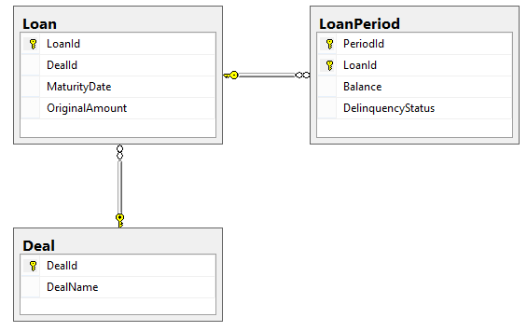
The SQL Setup
Given this Schema

Slide 3
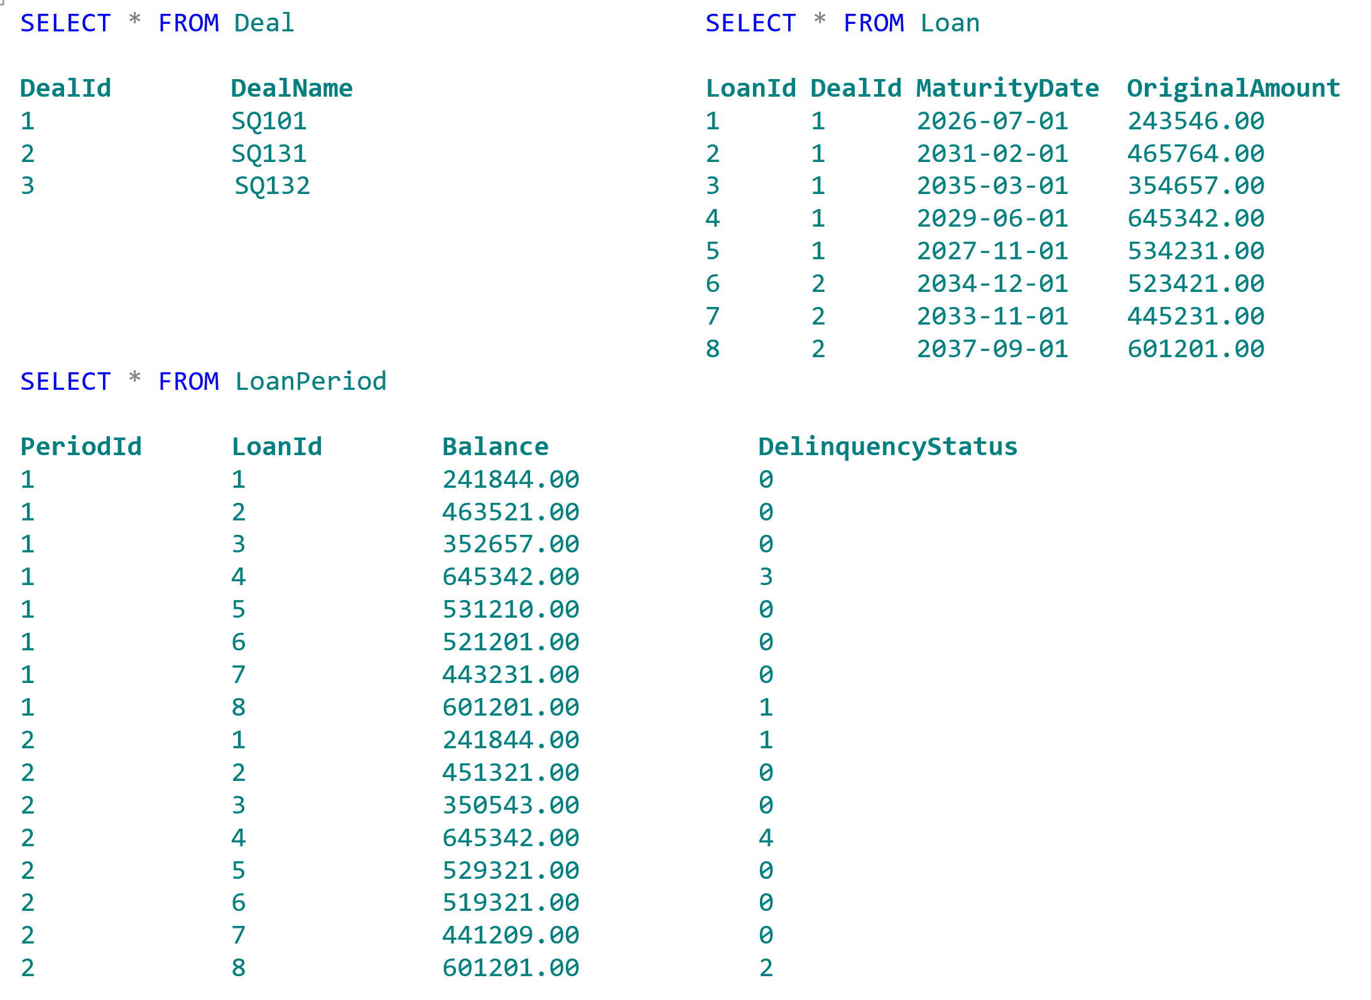
The SQL Setup
And this data

Slide 4
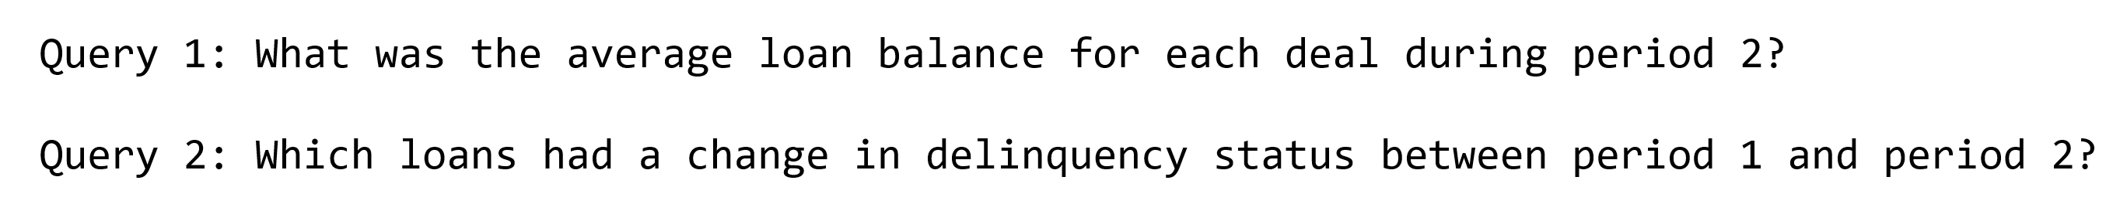
The SQL Challenge
Write Queries to answer these questions

Slide 5
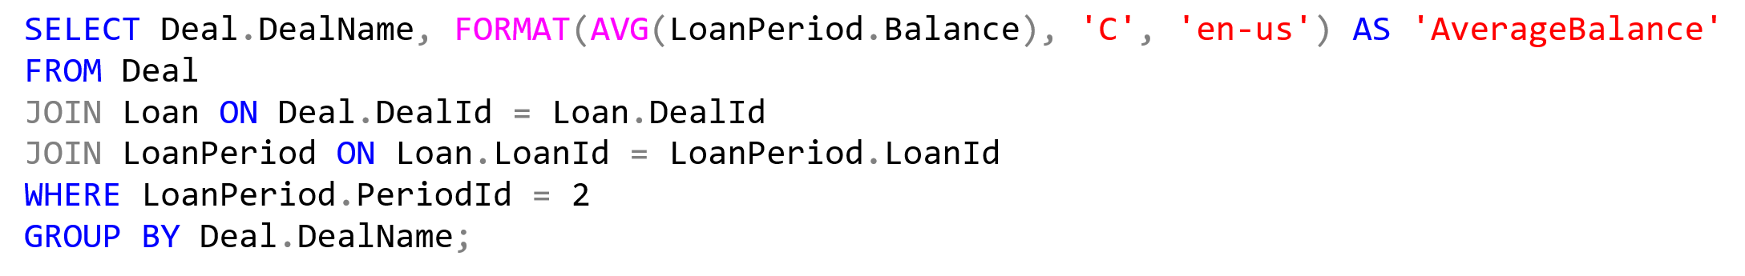
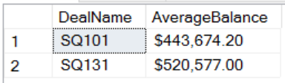
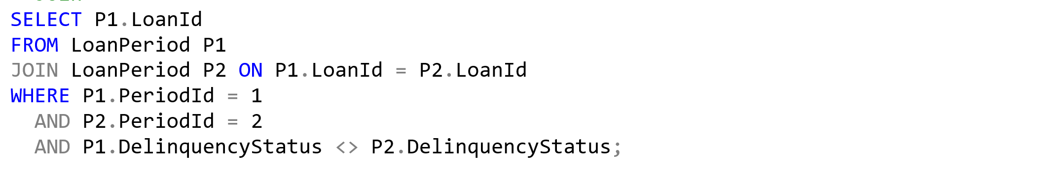
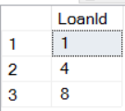
The SQL Answers
Queries to answer the questions

Slide 6
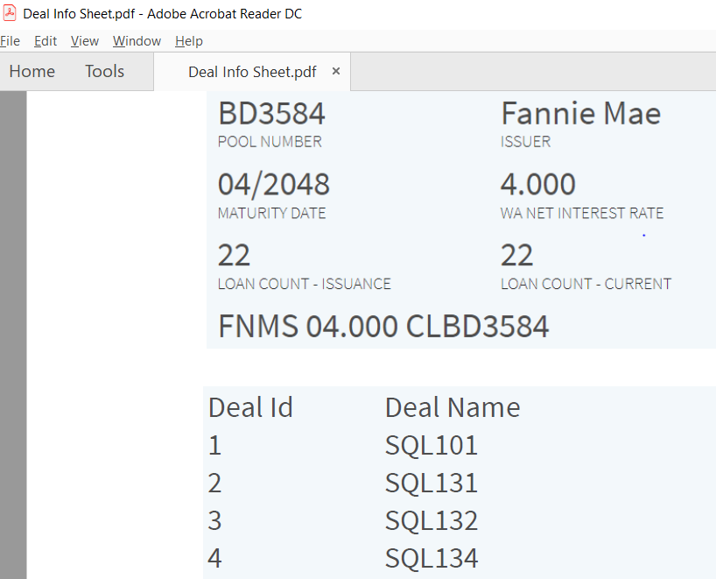
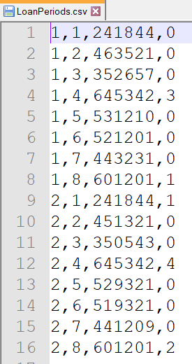
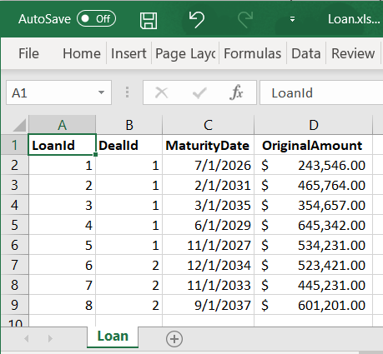
Analyst Challenge
Notes:
Here are the three objects Deals, Loans and Periods.

Slide 7
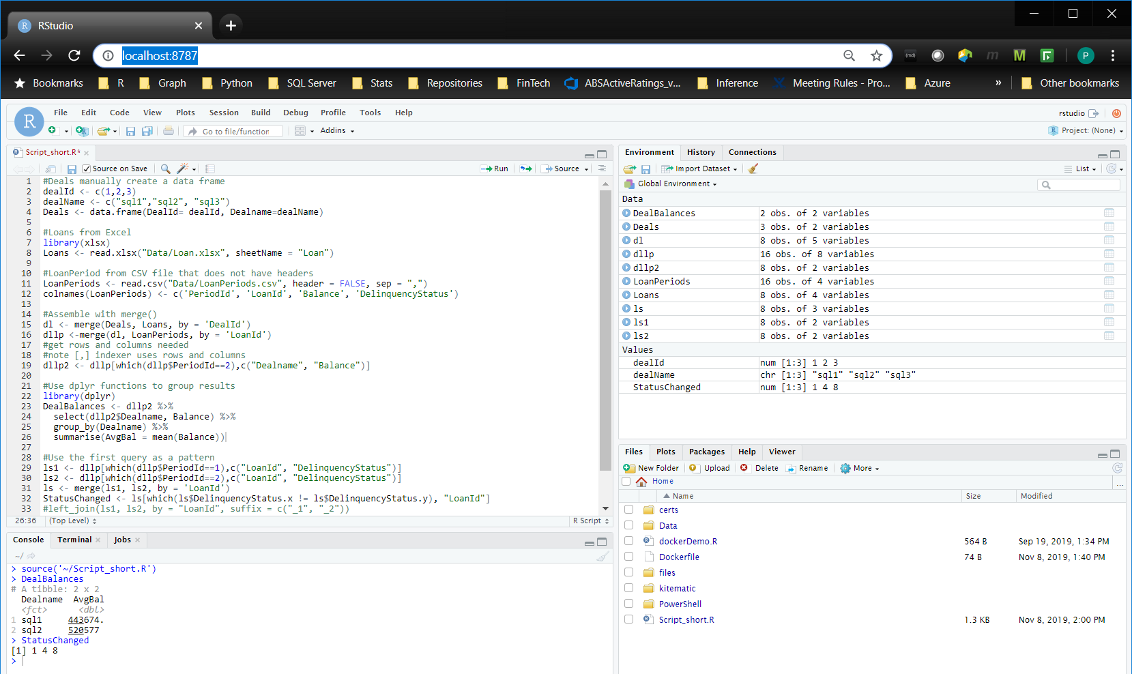
Analysts can meet their challenge in RStudio
Note: This instance of RStudio is running in a Docker container
Notes:
Matt McDonald presented his overview of Quantitative Modeling where he showed that we need to move away from Excel.

Slide 8
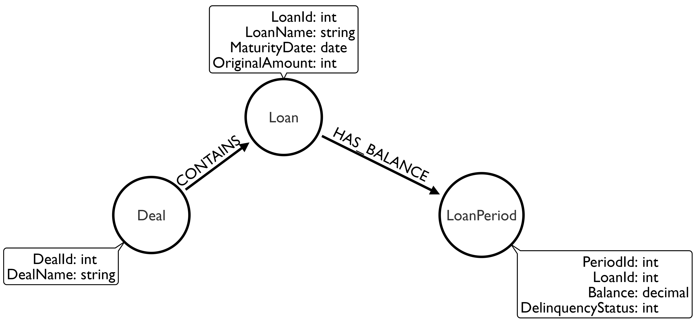
The Graph Model
Given this Model

Slide 9
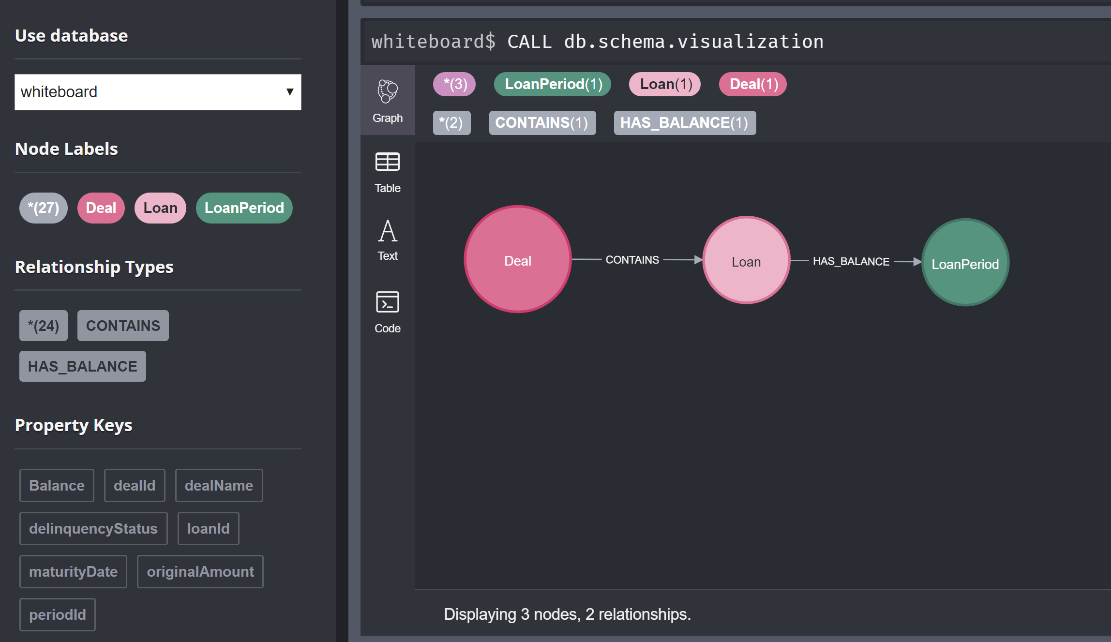
The Graph ETL Challenge
Load from CSV files to create Nodes and Relationships shown here

Slide 10
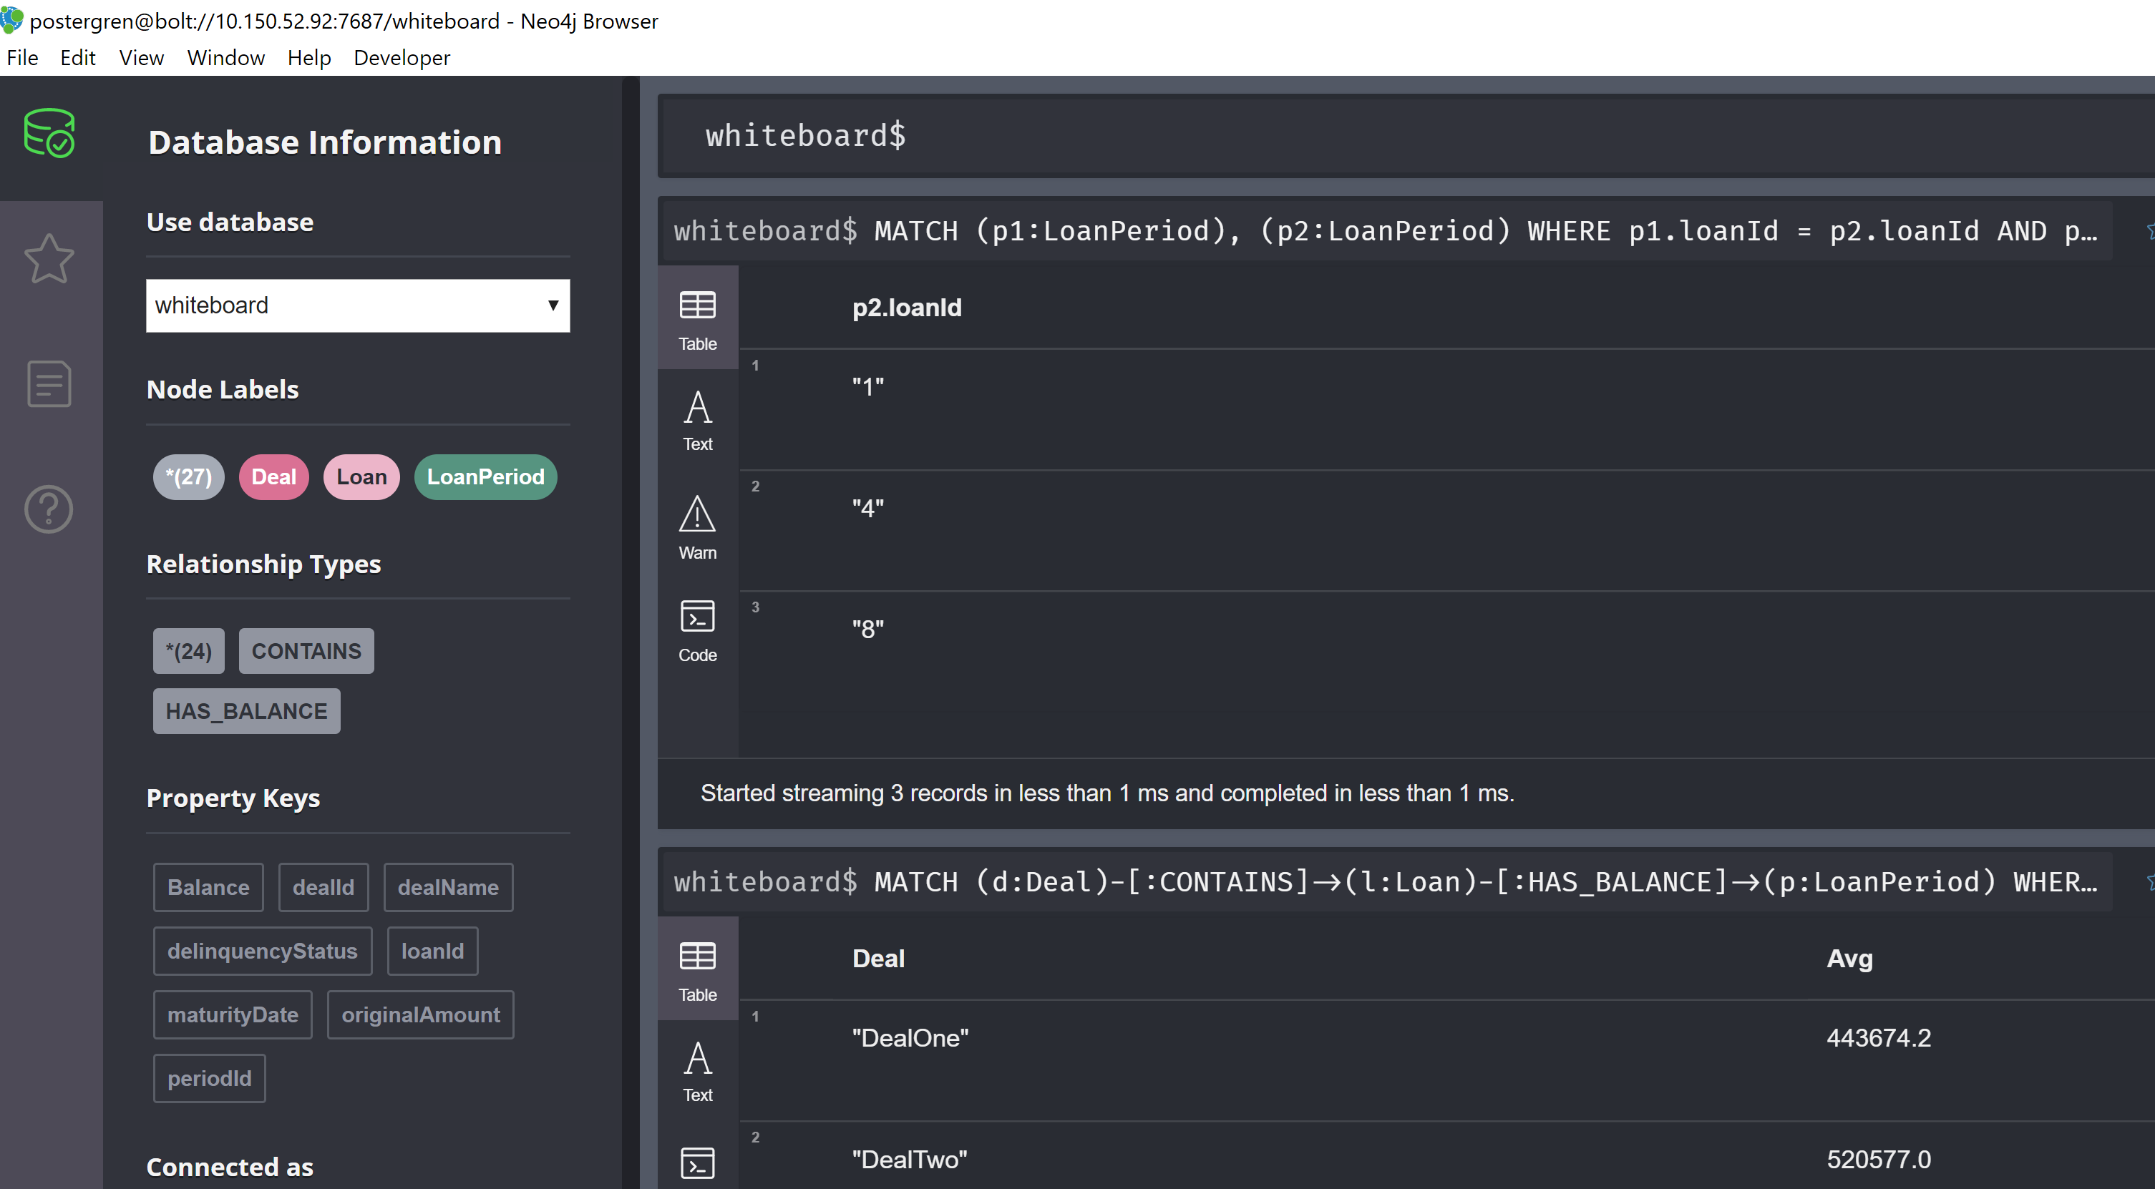
The Graph ETL Challenge
To run Cypher Queries to answer the two questions:

Slide 11
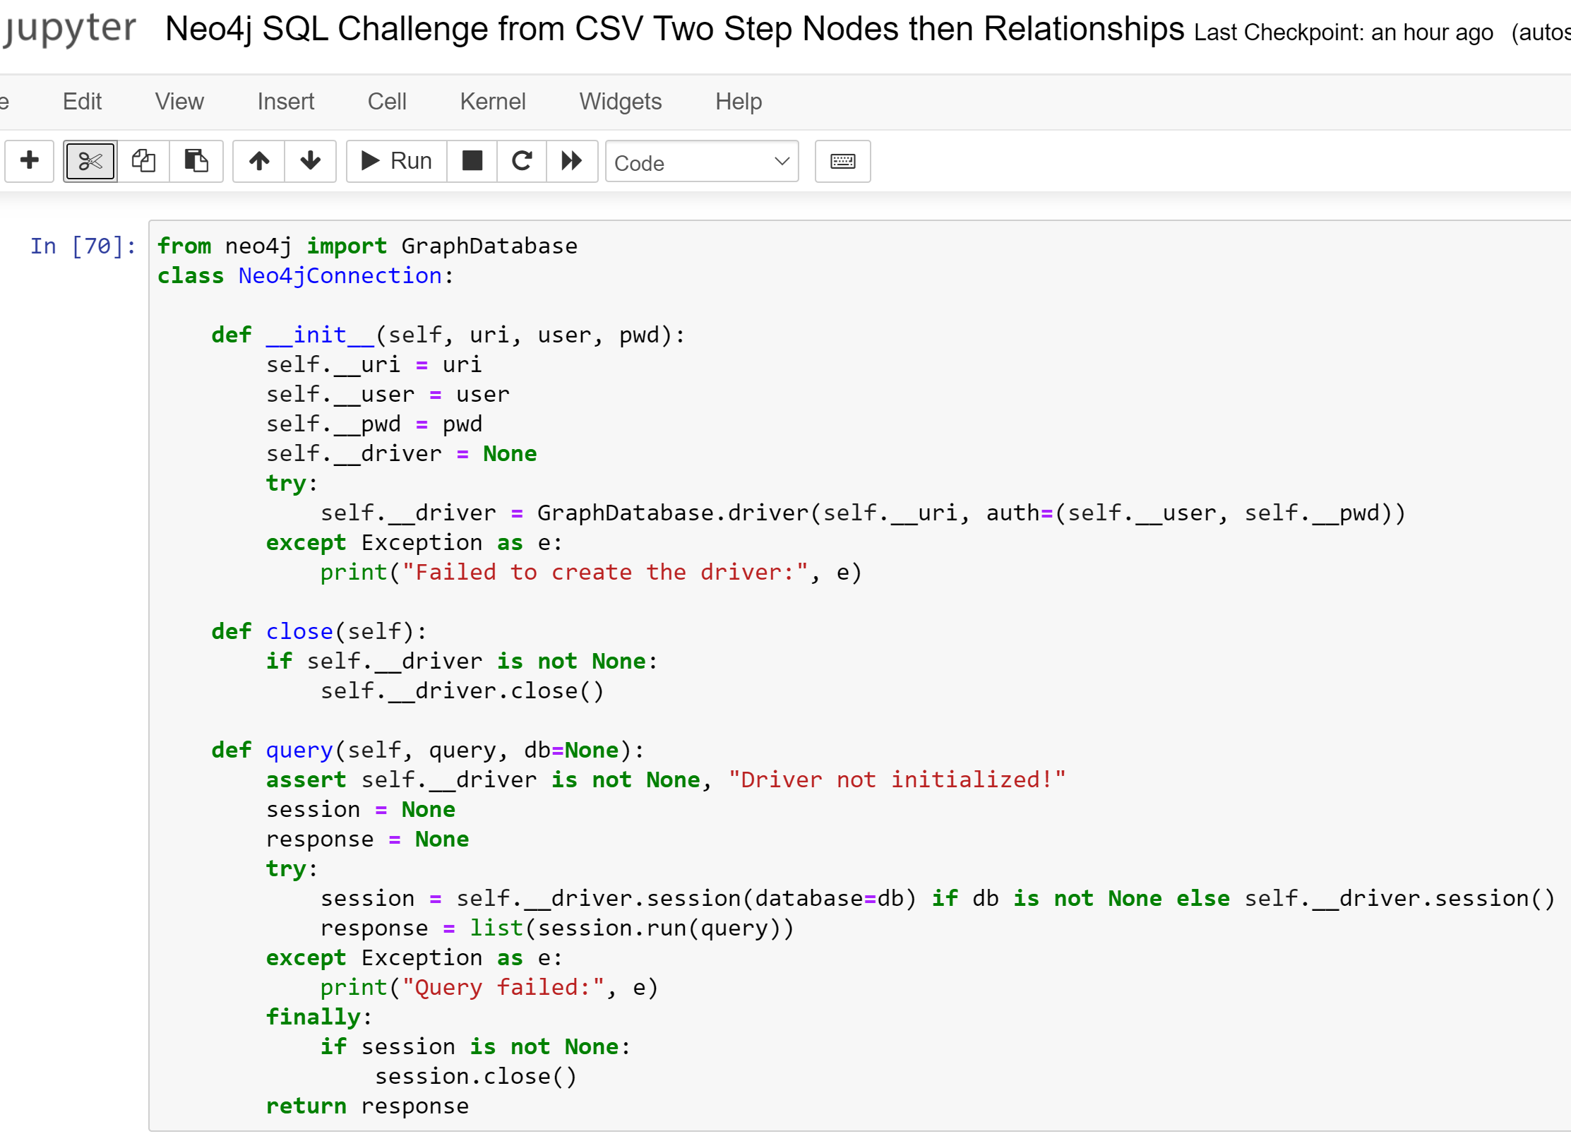
Mockup Python Class in Jupyter

Slide 12
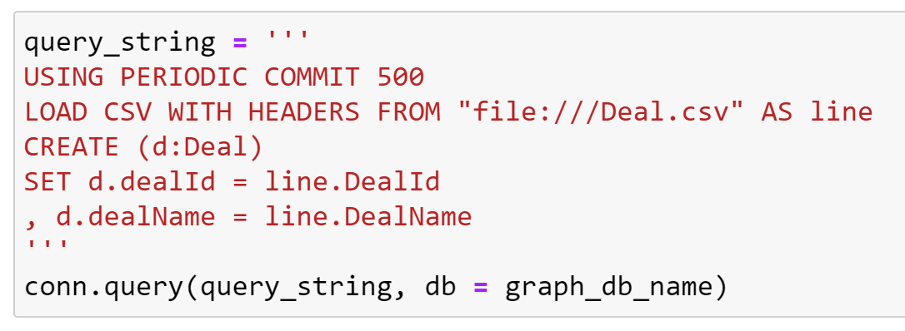
Step 1 Create Nodes
Deals:

Slide 13
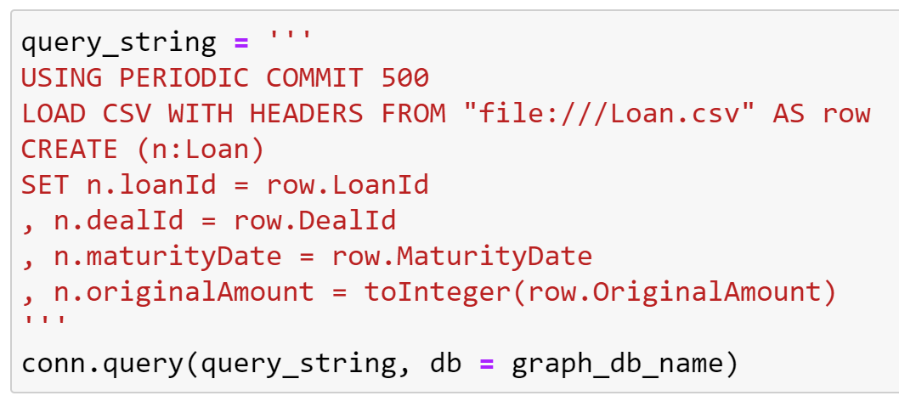
Step 1 Create Nodes
Loans:

Slide 14
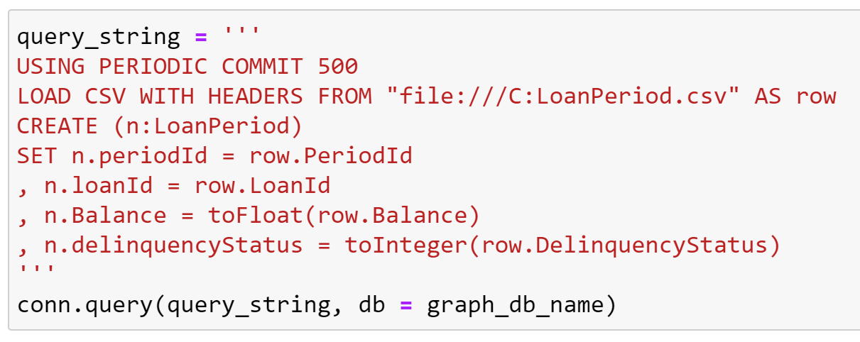
Step 1 Create Nodes
Loan Periods:

Slide 15
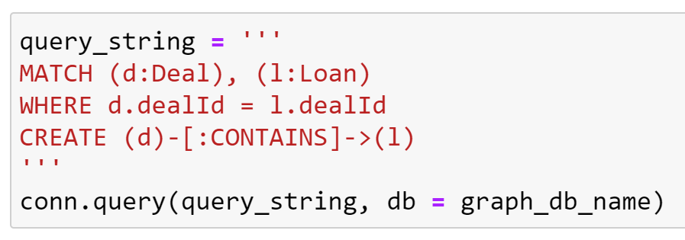
Step 2 Create Relationships
Deal to Loan:

Slide 16
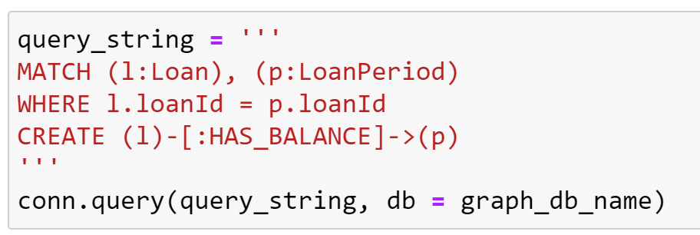
Step 2 Create Relationships
Loan to Loan Period:

Slide 17
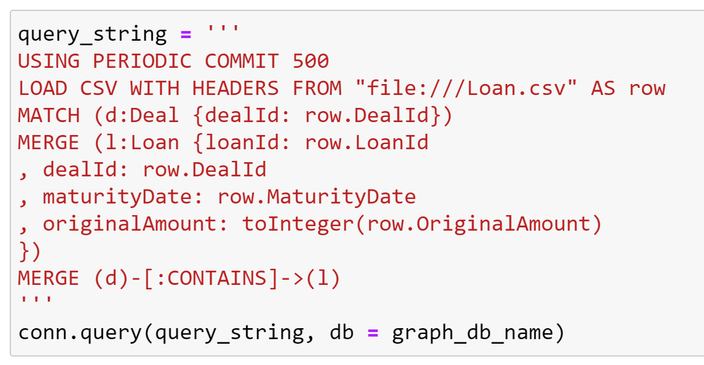
Alternative Relationship Creation Method
Create Deal nodes to serve as MATCH anchor

Slide 18
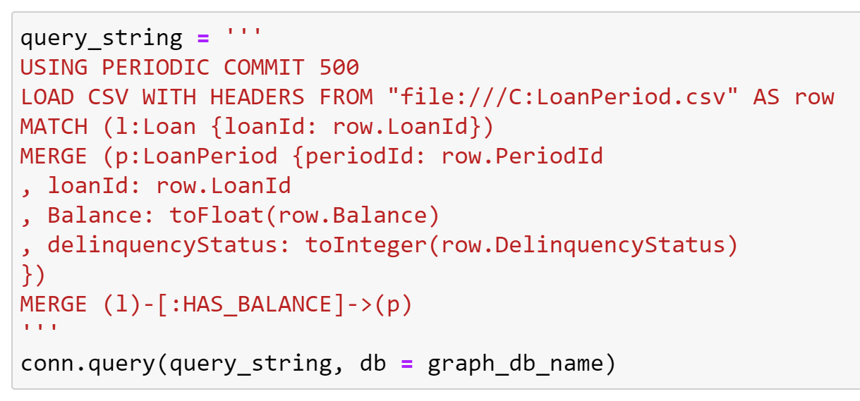
Alternative Relationship Creation Method
Progressively MATCH to anchor nodes created the model path

Slide 19
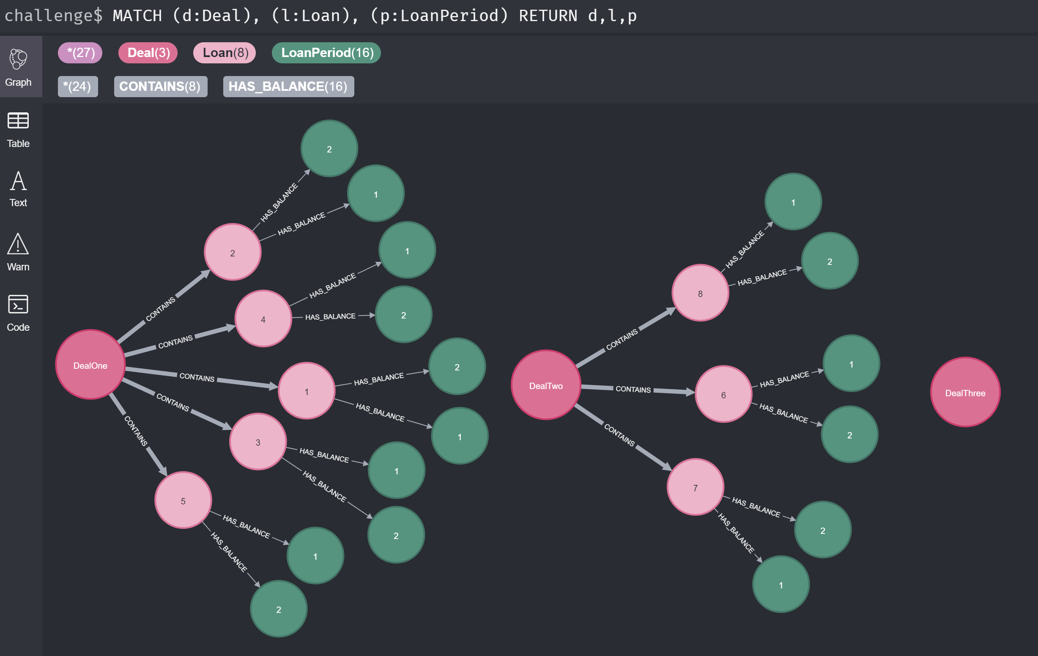
Alternative Relationship Creation Method
Either method creates same set of objects

